Slide 1


LOGISTIC
REGRESSION

Slide 2

BASICS OF CLASSIFICATION
Example: Spam Email Detection
Goal: Classify emails as Spam or Not Spam.
Data:
Email 1: "You’ve won a lottery!" → Spam
Email 2: "Meeting at 3 PM." → Not Spam
Training:
Learn patterns from data:
Words like "lottery" → Spam
Words like "meeting" → Not Spam
Prediction:
"Claim your prize now!" → Spam
"Submit the report by Friday." → Not Spam
Why Classification?
It assigns data to one of two categories: Spam or Not Spam.

Slide 3
LOGISTIC VS LINEAR REGRESSION
Logistic Regression vs Linear Regression
Linear Regression:
Imagine you’re predicting house prices based on size. The output can be any number, like $100,000 or $200,000.
Logistic Regression:
Now, imagine you’re predicting whether someone will buy a house (Yes or No). Instead of giving a number, it gives a probability (e.g., 70% Yes, 30% No) and decides based on that.
Key Difference:
Linear regression predicts numbers.
Logistic regression predicts categories like Yes/No or Spam/Not Spam.

Slide 4
QUIZ TIME
Predicting House Prices
Predicting the price of a house based on size, location, and number of bedrooms.
Spam Email Detection
Predicting whether an email is spam or not spam based on its content.
Exam Score Prediction
Predicting a student’s final score based on study hours.
Pass/Fail Prediction
Predicting whether a student will pass or fail an exam based on their attendance and study
Predicting Temperature
Predicting tomorrow’s temperature based on weather patterns.
Disease Diagnosis
Predicting if a patient has diabetes (Yes or No) based on health metrics like blood sugar
Car Mileage Prediction
Predicting how many miles per gallon a car can achieve based on engine size.
Loan Approval
Predicting whether a loan application will be approved or rejected based on applicant data.
Sales Prediction
Predicting the number of products a store will sell next week based on advertising spend.

Slide 5

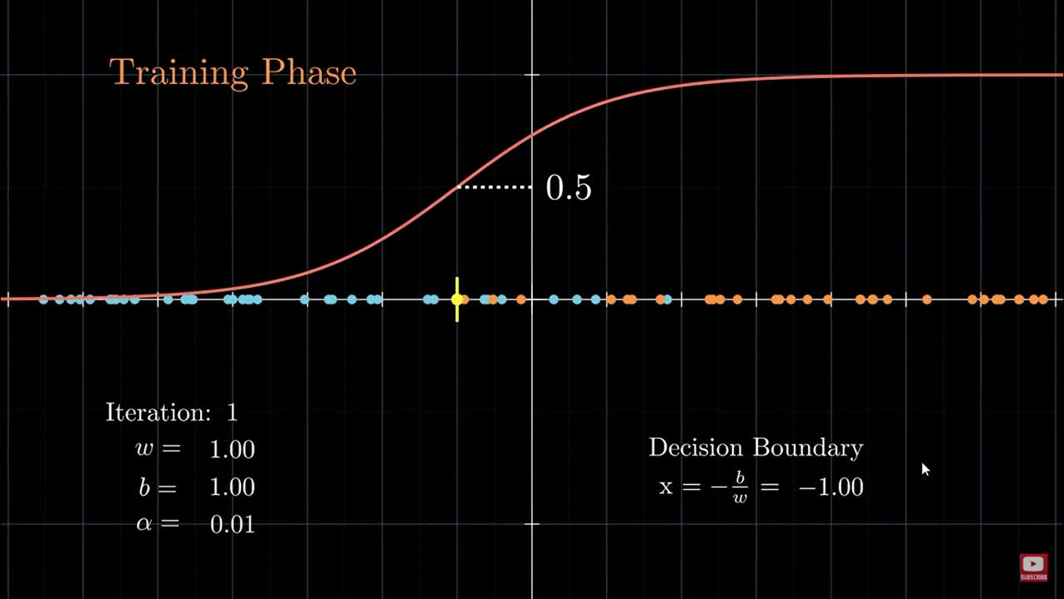
VISUALIZATION

